Slide 1
Exploring DDoS Attack and New security Technics
Tuhin Ahmed ID : 23173004
Fahim Arshadur Rouf ID : 23273002
Shaoun Chandra Shill ID : 23373005 Kazi Tanvir ID : 23373009
Team 18

Slide 2
Table of Contents
Introduction
Literature Review
Related Works
Methodology
Data Analysis
Result Analysis
Potential Challenges

Slide 3
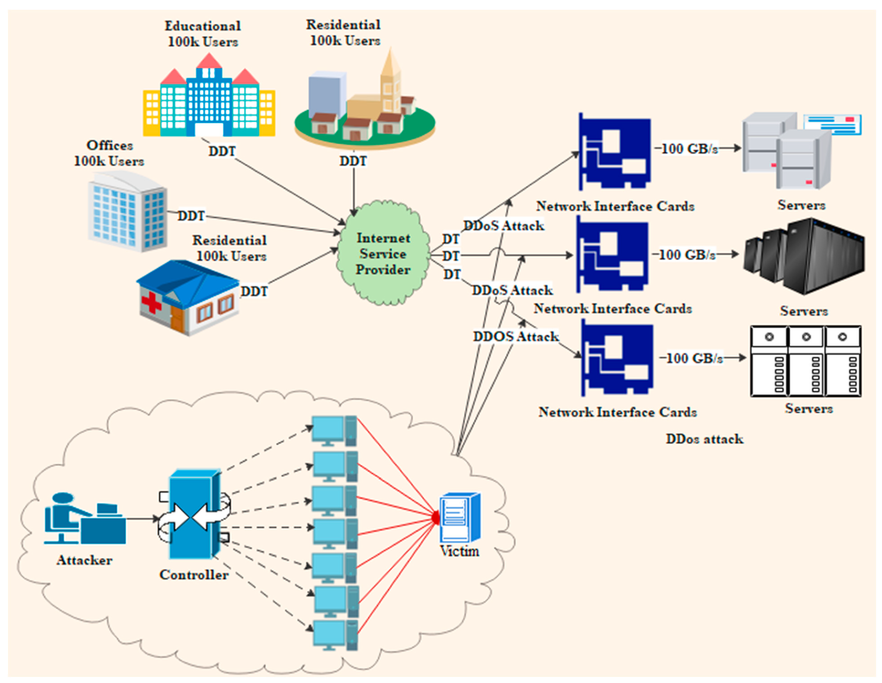
Introduction
The ongoing threat of Distributed Denial of Service (DDoS) assaults looms large in the complex web of cyberspace, posing a challenge to the resilience of digital ecosystems across the globe. The increasing dependence we have on networked technologies has increased the power of malicious actors who aim to undermine, damage, and destroy online systems. At the same time, it maneuvers through the state-of-the-art of cybersecurity, where new methods and approaches are developed to counter the always changing strategies of cyber enemies. As we go out on this adventure, we examine the classifications of DDoS assaults, their historical development, and the motivations behind their planning. Armed with this basic knowledge, we navigate the halls of modern cybersecurity, where AI, ML, and novel approaches surface as the front-runners in defense. We hope to shed light on the nuances of DDoS attacks as well as the exciting potential of security technologies that act as barriers against the digital storm through our investigation.

Slide 4
Literature Review
The body of research on DDoS assaults and modern security methods creates a complex mosaic that captures the changing nature of cybersecurity. Analyses of the past illustrate how DDoS attacks developed from primitive to highly complex, widespread disruptions that are seen in the present day. The reasons behind DDoS attacks are examined in a large body of literature, and the results show a spectrum including financial incentives, ideological objectives, and geopolitical ambitions. Case studies of notable DDoS events, like the botnet-driven strikes on Mirai, offer priceless insights into the workings of these attacks and their domino effects on the targeted businesses. Simultaneously, the literature presents the standard protection measures used to counter DDoS attacks. Research highlights the function of load balancers, firewalls, and intrusion prevention systems (IPS), illuminating both their advantages and disadvantages.

Slide 5
Related Works
First DDoS Attack (1974)
DDoS Attack Detection Method Based on Improved KNN With the Degree of DDoS
Attack in Software-Defined Networks. [2]
Quick Suppression of DDoS Attacks by Frame Priority Control in IoT Backhaul With Construction of Mirai-Based Attacks. [3]
DDoS Attack Mitigation Based on Traffic Scheduling in Edge Computing- Enabled TWDM-PON.[4]

Slide 6
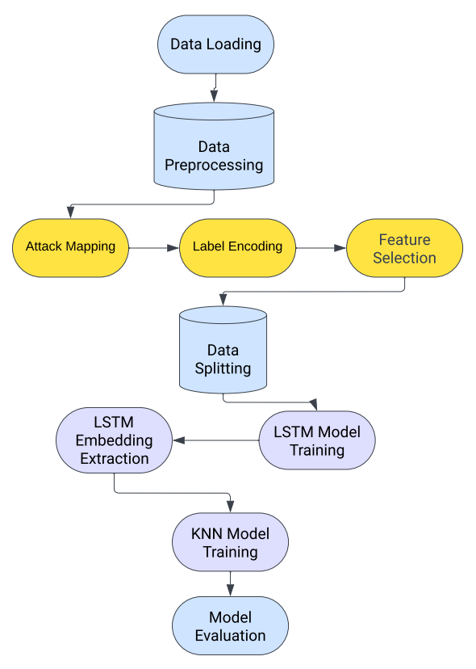
Methodology

Slide 7
Data Analysis : Challenges
Traditional DDoS Detection Challenges:
Signature-based algorithms limitations
Inability to recognize new attack types
Dynamic traffic behavior challenges statistical anomaly detection
Importance of Advanced Techniques:
Need for new and efficient DDoS detection technologies
Introduction of LSTM-KNN approach to address these challenges

Slide 8
Data Analysis : Overview
Overview of LSTM and KNN:
LSTM's strength in recognizing temporal correlations in data
KNN's use of distance metrics for precise attack identification
Two-Pronged Method:
LSTM model scans network traffic, identifies potential DDoS segments
KNN evaluates low-confidence LSTM outputs for further examination
Advantages of LSTM-KNN:
Enhanced Precision: Combining LSTM and KNN for thorough detection
Enhanced Robustness: Two distinct algorithms for resilience to various attacks
Generalization Capability: Trained on diverse datasets for flexibility

Slide 9
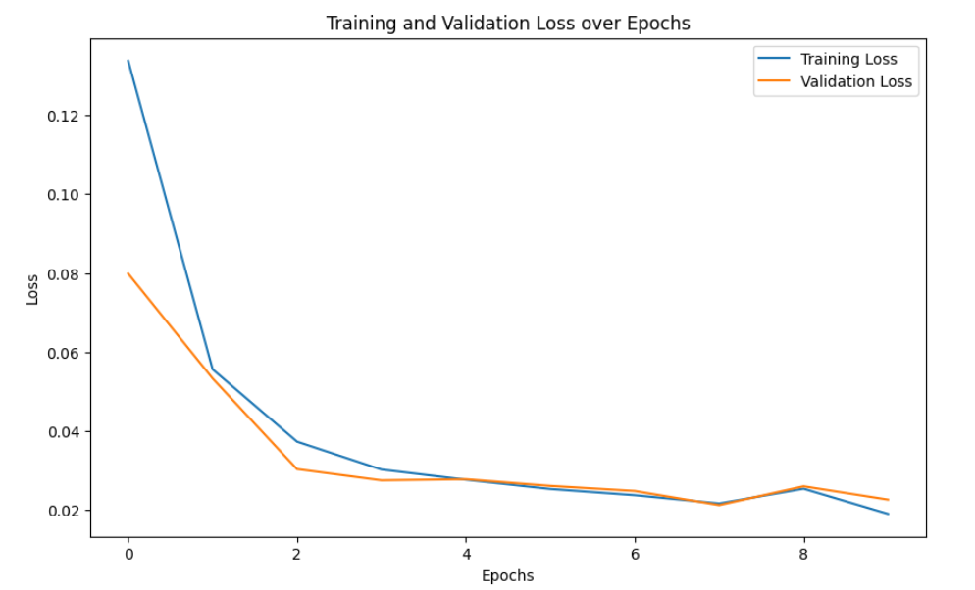
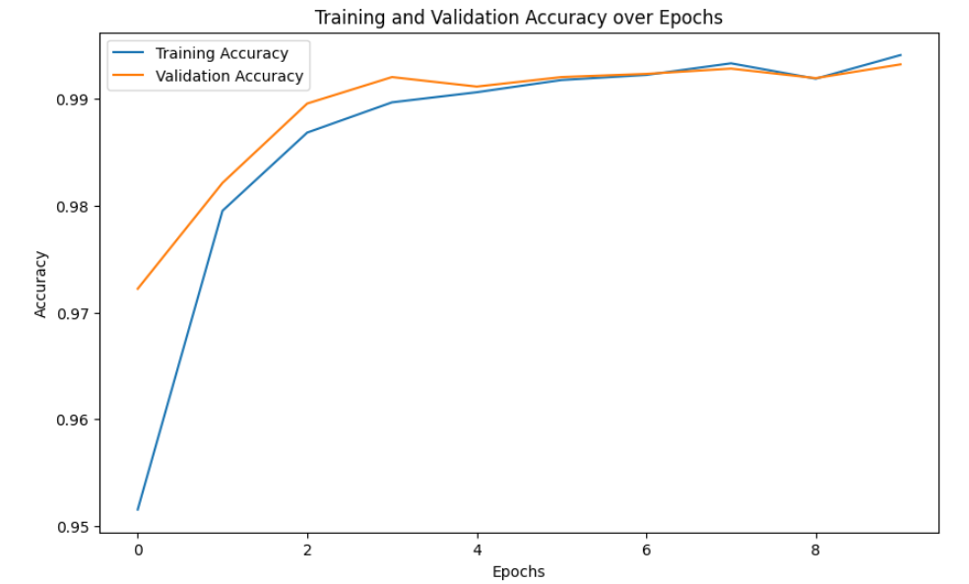
Result Analysis

Slide 10

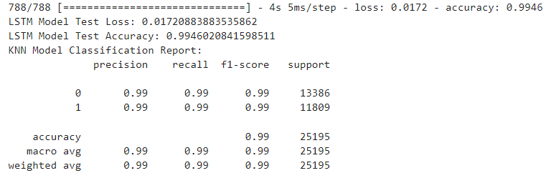
Result Analysis

Slide 11


Result Analysis

Slide 12
Potential Challenges
Service Disruption
Financial Impact
Reputation Damage
Increased Costs
Intellectual Property Theft
Service Quality Degradation
Legal and Regulatory Consequences
Complex Attribution

Slide 13
References
D. Dennis, “The First DDoS Attack,” in Motherboard, Vice, 2014. [Online]. Available: https://motherboard.vice.com/en_us/article/wnjwb4/the-first-ddos-attack-was-40-years-ago-today. [Accessed: Nov. 25, 2023].
S. Dong and M. Sarem, "DDoS Attack Detection Method Based on Improved KNN With the Degree of DDoS Attack in Software-Defined Networks," in IEEE Access, vol. 8, pp. 5039-5048, 2020, doi: 10.1109/ACCESS.2019.2963077.
R. Harada et al., "Quick Suppression of DDoS Attacks by Frame Priority Control in IoT Backhaul With Construction of Mirai-Based Attacks," in IEEE Access, vol. 10, pp. 22392-22399, 2022, doi: 10.1109/ACCESS.2022.3153067.
Y. Li, Y. Zhao, J. Li, X. Yu, Y. Zhao and J. Zhang, "DDoS Attack Mitigation Based on Traffic Scheduling in Edge Computing- Enabled TWDM-PON," in IEEE Access, vol. 9, pp. 166566-166578, 2021, doi: 10.1109/ACCESS.2021.3134671.

Slide 14
Thank you

